Slide 1
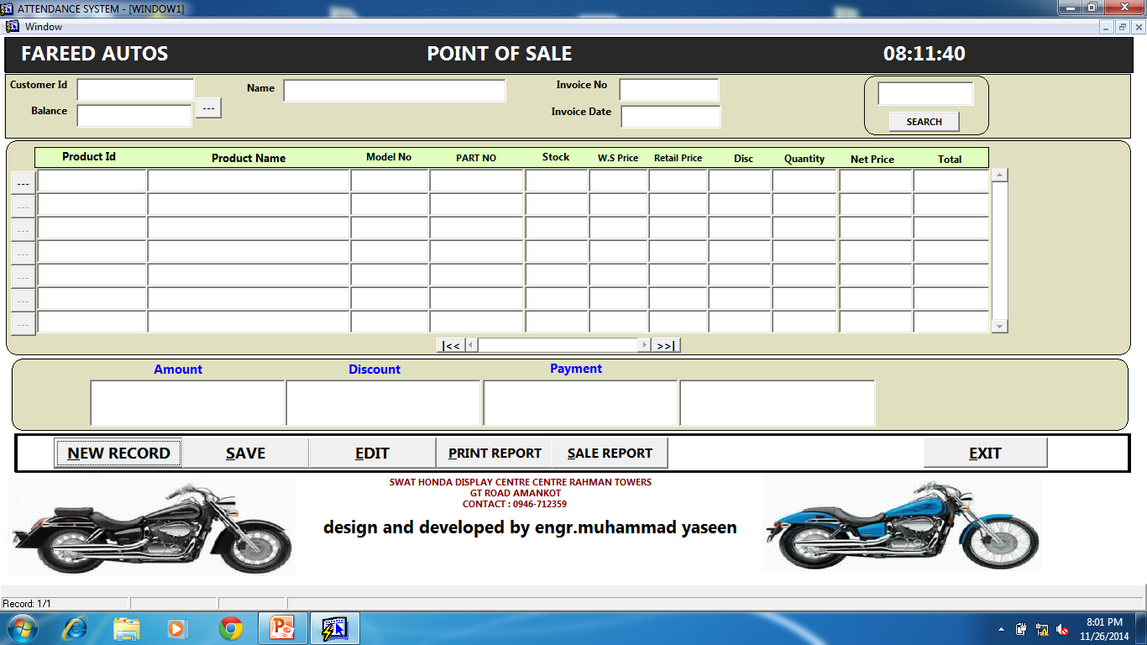

Slide 2
Sale Return
Sale return form will do the functional opposite of sale .it will return all the products from customers and will update the accounts and product stock.
It include sale return reports
Customer payment
In this section we update payments of all customer who come and pay .
Payment to supplier
In this section we update our own payments to supplier.

Slide 3
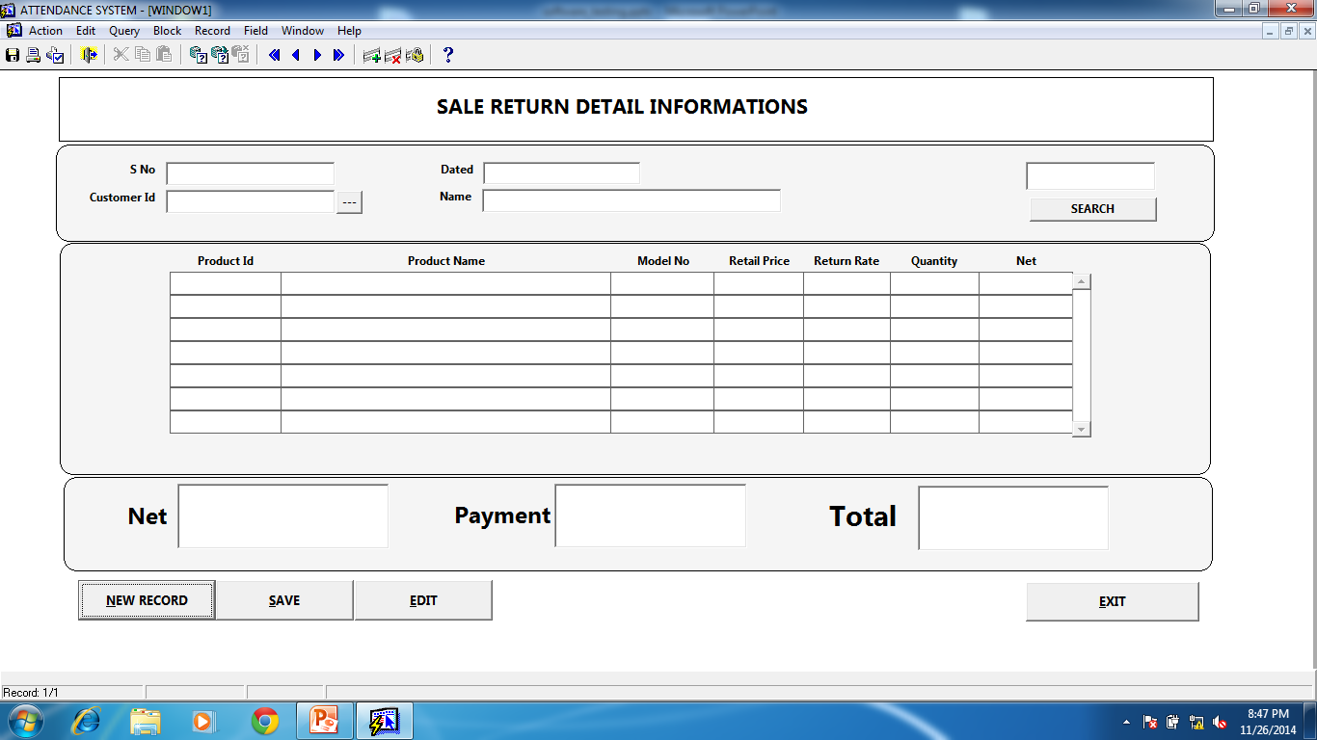

Slide 4
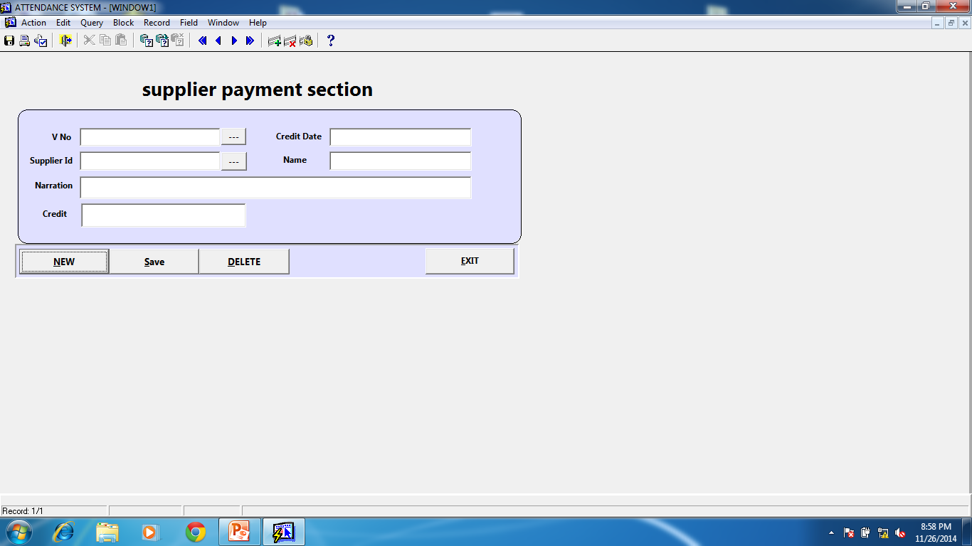

Slide 5
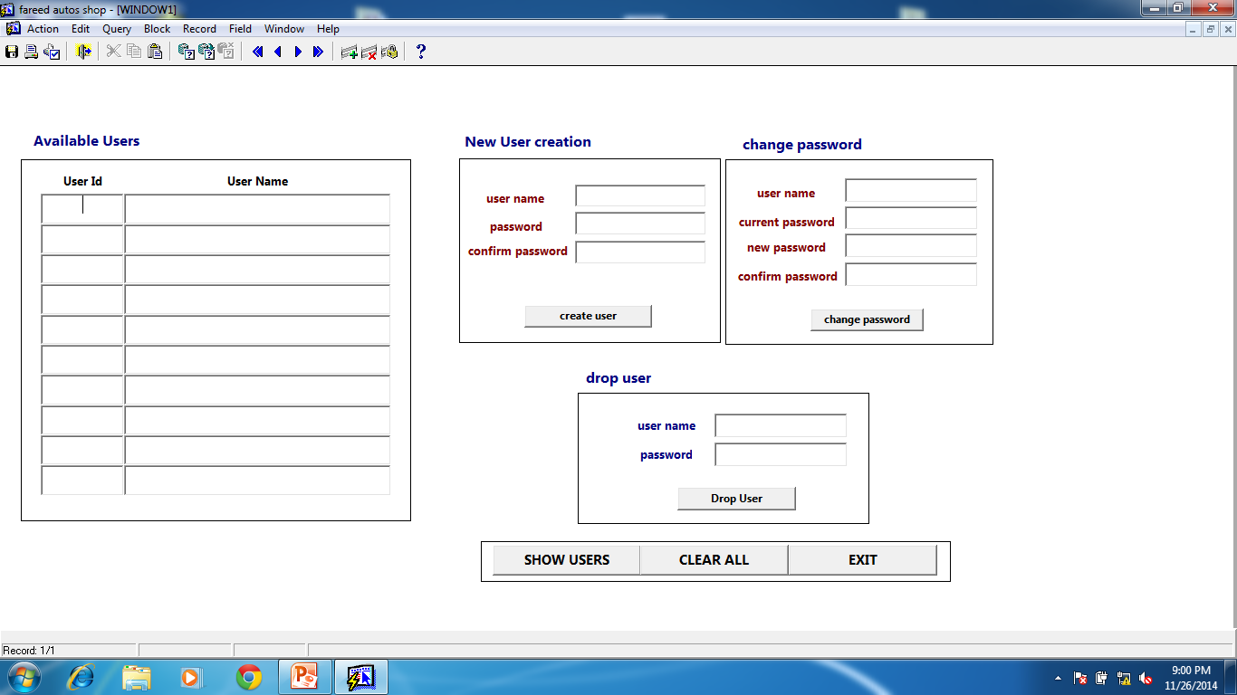

Slide 6
ASSIGNMENT NO 4
Write a complete test plain template document for the case study ( 6 to 10 pages )
Last date of submission is : 15-DEC-2014
NOTE : copy assignment or copy idea will be mark in negative
Also note marking of this assignment will b based on quiz in this assignment

Slide 7
Identify set of tests for this project
SYSTEM TEST ?
INTEGRATION TEST ?
UNIT TEST ?
NON FUNCTIONAL TESTS ?

Slide 8
TEST CASES
First design test cases for system test first
System test for modules
1) Product 2) customer and supplier 3)point of purchase 4) point of sale 5) point of sale 6) sale return 7) supplier and customer accounts

Slide 9
Test case id : 1
Product module : product stock detail
Test case description : this test case is designed for system test (module test)of a particular product detail. Here we will validate this module against functional requirements. This test comes under category of black box testing.
Test steps :1) module is complete or something is missing
2) first we check the entry of product stock is correct or not
3) Then we will check the searching of record by product id / name is correct or not
4) We will check for reports, generating correctly or not and the module contain all the specified reports or not
Test data: test data are text fields ( product_id,product_name,model_no,part_no) and buttons( new, save , delete,exit),list of values buttons,searching record list item etc.
Expected output : 1) it save record successfully
2) It search record successfully
3) The form and reports should be completed
4) The reports should be correctly generated
Actual output : ???????

Slide 10
Test case id : 2
Product module : point of purchase
Test case description : this test case is designed for system test (module test) for point of purchase. Here we will validate this module against functional requirements. This test comes under category of black box testing.
Test steps :1) module is complete or something is missing
2) first we check the entry to this module is correct or not
3) The record is saving and updating correctly or not
4) We will check for reports, generating correctly or not and the module contain all the specified reports or not
5) The integrated module with this software like supplier accounts system and product stock detail works correctly or not
Test data: test data are text fields ( product_id,product_name,model_no,part_no) and buttons( new, save , delete,exit),list of values buttons, reports etc.
Expected output : 1) it save record successfully
2) It edit record successfully
3) The form should be completed
4) The modules integrated with this point of purchase should b edited and updated successfully
5) The product should be updated correctly incase where dual entry of same product are entered
Actual output : ???????

Slide 11
Test case id: 3
Product module: point of purchase (edit button)
Test case description: we are going to design a unit test for edit portion of point of purchase because there are a lot problems and it effect user requirements and system .and it fails system test.This test comes under category of white box testing.
Test steps : exercise whole code step by step. Correct it and make it complete
Test data: 1) programming code
Expected output : 1)identify the problems 2) regression test 3) check every possible scenario while exercising this code 4)as this test is done by the developer so we hope he will fix all the problems
Actual result : ??????

Slide 12
Test case id: 4
Test description: designing a system test for supplier accounts .
Test steps: 1) completeness 2) entry checking 3)record saving in supplier debit and credit section
4) Check searching of record
Test data: text box, buttons actions by validating the module against functional requirements.
Expected output: the whole module works correclty,records (debit and credit) are updating and saving correctly.
Actual output: ??????

Slide 13
ASSIGNMENT NO 5
Q.1) find out/discuss the errors in point of purchase, point of sale, along with its integrated modules in detail by doing system test?
Q.2) give suggestions how to fix these errors ?
Q.3) discuss how the performance of this software and architecture of this software can be improved further ? If possible draw alternatives architectures for any one of the above modules in detail ?

